Slide 1

Cloud
Computing
Akunma Ndujiuba
Ioana Nicolae
William Moorby
Zeeshan Javed
Notes:
A

Slide 2
What is Cloud Computing?
The delivery of computing services over the internet.
Advantages
Disadvantages
+
-
Ease of use
Flexibility
Robustness
Better security
Increased collaboration
Better quality control
Cost savings
Data leakage
Limited control and flexibility – ROTP
Vendor lock-in
Downtime – ROTP
Data mobility
Network connectivity dependency
Notes:
A:
Instead of investing in their own computing infrastructure, individuals, governments and companies can rent access to applications and storage from a cloud service provider (AWS, Azure, Google Cloud, etc)

Slide 3


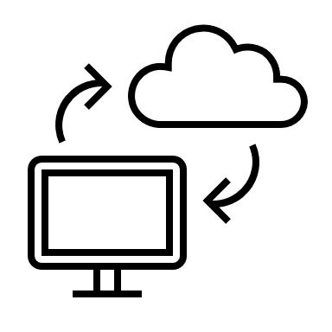
Cloud Infrastructures
01
02
On-premise
Public Cloud
All data is in house and stored locally.
Data is hosted on a vendor’s server (e.g. AWS).
04
03
Multicloud
Hybrid Cloud
Entails multiple cloud services from one or more providers (e.g. AWS for application workloads and Microsoft Azure for enterprise database).
A hybrid cloud solution is a mix of public cloud and private cloud infrastructure (e.g. Netflix).
Notes:
Z:
On prem means on premises data centres which allow you to have full control of your infrastructure. All data is in house and stored locally.
Public cloud - is in regards to data which is hosted on a vendor's server (such as AWS) and accessed via a web browser.
Hybrid Cloud - Using the example of a bank which hosts public data such as how to apply for a loan or a mortgage as well as ultra confidential data such as bank pin numbers etc. a system is needed in order to host both. Usually this is known as Hybrid Cloud. The public data is stored upon the public cloud service whereas the confidential is stored on prem - as the bank is responsible for it. It is a combination of a public and a private cloud.
Netflix uses hybrid cloud data storage due to its on-demand and pay-per-use features. and due to spikes in bandwidth demand when a new series debuts.
Also AWS came up with Gov Cloud - a secure cloud service that one can only use if they are a part of the government. As a member of the public access to Gov cloud is denied and is only available for select agencies. For example, CIA and NASA use this service.
Multi Cloud Multi-cloud entails multiple cloud services from one or more providers, for example AWS for application workloads and Microsoft Azure for enterprise database. 92 % of companies use a multi cloud system as it provides for a flexible approach - one cloud system could cater for a certain part of your business better than another. Also it helps to reduce poor response times for cloud users, some workloads could be hosted by regional cloud providers that operate closer to where the users are. This solution lets the enterprise maintain high availability and adhere to data sovereignty laws—protocols that subject data to the regulations of the country in which that data is located. This strategy is also cost-effective, where the competitive market strives to offer optimal pricing for different resource capacities.

Slide 4
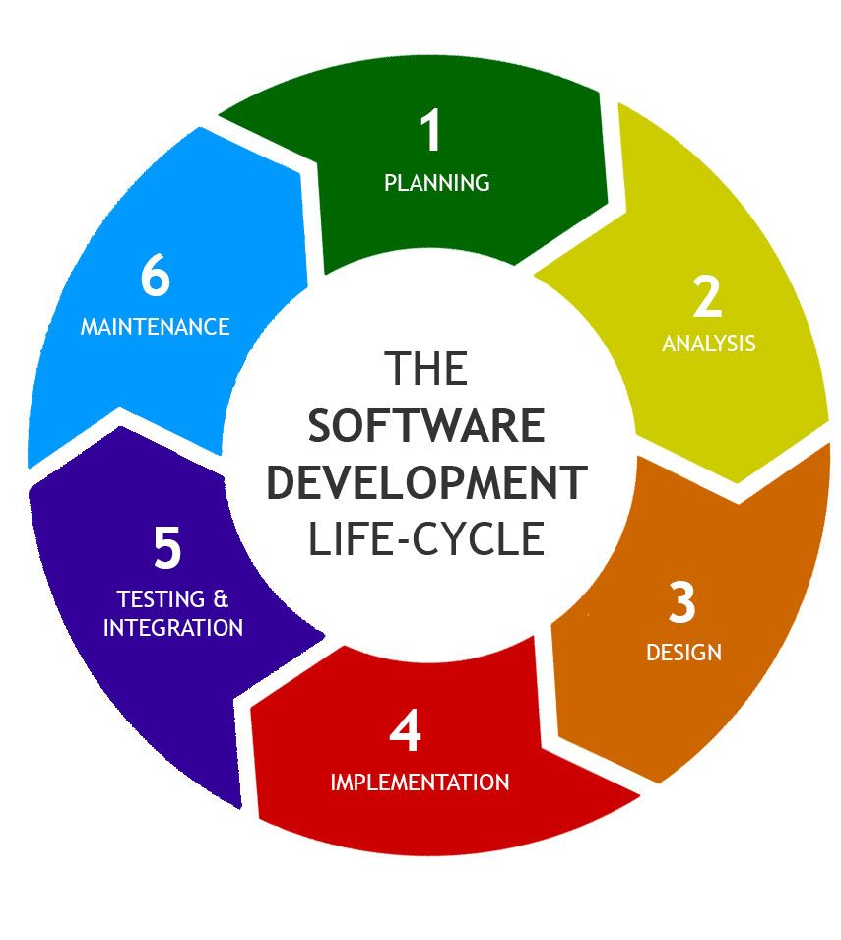
SDLC & Risk Levels
LOW - planning, analysis, design
Medium- development, testing
High - implementation, maintenence
Notes:
Z:
Software Development Life Cycle is a process for planning, creating, testing and deploying an information system The seven new stages: planning, analysis, design, development, testing, implementation, and maintenance.

Slide 5
Virtualization
Virtual versions of hardware elements
Software is used to simulate functionality
Scalability
Efficiency
Can run more than 1 virtual computer system
Availability of resources, automated operations
Notes:
A:
Virtualization relies on software to simulate hardware functionality and create a virtual computer system. This enables IT organizations to run more than one virtual system – and multiple operating systems and applications – on a single server. The resulting benefits include economies of scale and greater efficiency.
Virtualization uses software to create an abstraction layer over computer hardware that allows the hardware elements of a single computer—processors, memory, storage and more—to be divided into multiple virtual computers, commonly called virtual machines
Virtualization can increase IT agility, flexibility and scalability while creating significant cost savings. Greater workload mobility, increased performance and availability of resources, automated operations

Slide 6
Development Environment
1
Definition
2
IDE
A workspace for developers to make changes without breaking anything in a live environment.
It is designed to maximize productivity and efficiency for the developer.
3
How?
4
Examples:
It is set up on a local machine or server, where the website’s source code is downloaded, so it is ready to be changed and modified.
Microsoft Visual Studio
Eclipse
Netbeans
Adobe Flex Builder
Glade
Notes:
I:
A development environment in software and web development is a workspace for developers to make changes without breaking anything in a live environment. An integrated development environment is often used as a programming tool to assist the developer. An integrated development environment (IDE) is the software suite used by developers and is designed to maximize productivity and efficiency for the developer.
The purpose of a development environment is to have a place for a developer to test anything they want without worrying about it affecting any end-users or content editors working on a live website. In most cases, a development environment is set up on a local machine or server, where the website’s source code is downloaded, so it is ready to be changed and modified. To help with the development process an integrated development environment (IDE) is often used.

Slide 7

MultiServer Environment
A multi-server environment involves two or more servers running simultaneously with a shared database and shared folders.
The multi server environment allows more effective monitoring of the resources.
One of the best things about using multiple servers is that it provides better security against cybersecurity issues and other data protection problems.
MultiServer Environment Improves Server Performance and Resources Scalability
Notes:
I:
For the companies who have to deal with the confidential data, for example, banks who have to handle the confidential and financial information of clients should use the Multi-Server Environment by splitting off the databased from the servers. Separating the database would keep your information safe and secure and in case of any cyber-attack, your database would remain inaccessible for a hacker.
In the Multi-Server Environment, allocation of the system resources unequally to numerous servers depending on the needs of their functions, in doing so the resources can be efficiently used. The database server overall performance can often be upgraded by organizing it to cache common tables and queries, and by modifying the quantity of real-time connections acceptable

Slide 8
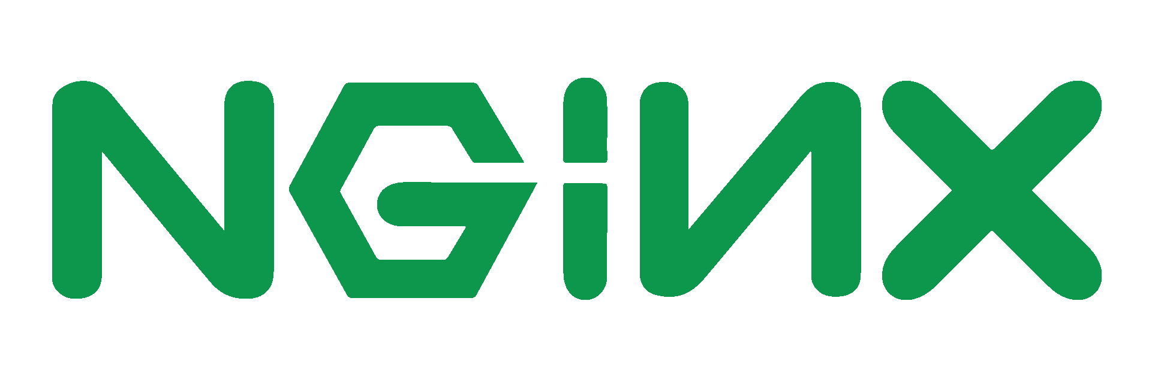
What is Nginx?
NGINX is an open-source software for web serving, reverse proxying etc.
It can handle a high volume of connections
NGINX are the best-in-class reverse proxy and load balancing solutions used by high-traffic websites such as Dropbox, Netflix, and Zynga. More than 400 million websites worldwide rely on NGINX Plus and NGINX Open Source to deliver their content quickly, reliably, and securely.
Notes:
Z:
It started out as a web server designed for maximum performance and stability.
Though NGINX became famous as the fastest web server, the scalable underlying architecture has proved ideal for many web tasks beyond serving content. Because it can handle a high volume of connections, NGINX is commonly used as a reverse proxy and load balancer to manage incoming traffic and distribute it to slower upstream servers – anything from legacy database servers to microservices.

Slide 9
Provisioning
VagrantFile will initialise machines, sync files from localhost machine and execute provision shell scripts.
Node-app Machine
Mongo-db Machine
Installs npm package manager
Installs Python software properties package
Installs nodejs package
Installs pm2 package
Edits the nginx configuration file (for reverse proxy)
Adds a DB_HOST environment variable
Installs MongoDB package
Edits the MongoDB configuration file
Starts MongoDB and allows it to start when the VM is initialised
Notes:
W:
provisioning the configuration of Node-app with mongo set up using Vagrantfile including reverse proxy set up.

Slide 10
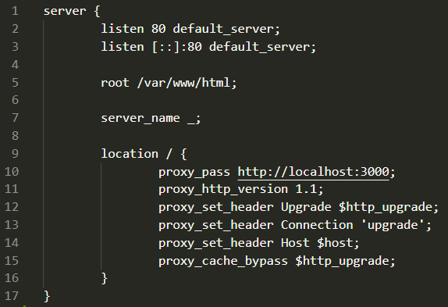
Provisioning
File is a copy of the default configuration file, only change is the location block. Main change is addition of proxy pass.
First line deletes the original config file for nginx.
Second line links the synced configuration file to the old path.
Notes:
W:
code execution demo to see app and db working in the browser without port 3000.
For the Node-app machine, this installs npm, python software properties, nodejs and pm2. The provisioning script also changes the nginx configuration file (for reverse proxy) and adds a DB_HOST environment variable.
For the Mongo-db machine, this installs mongodb and changes the mongodb configuration file.

Slide 11

Code execution demo
Notes:
W:

Slide 12
Thank you! Any questions?

